Slide 1
Machine Learning
Model of choice, including limitations and benefits
Why Linear regression model?
Pros:
Linear regression effectively modelling a linear relationship(of the form: Y = a + bX) between the input(x) and output(y)
Price of the rental unit is the dependant variable
features like bedrooms,bathrooms,size will be the independent variables
It is efficient to train and it handles overfitting pretty well .
Cons :
Linear regression is quite sensitive to outliers
The stronger the correlation ,the difficult it is to change one variable without changing another

Slide 2
Machine Learning
Data preprocessing
Data
Clean_housing_data.csv
Convert categorical data with Get_Dummies ()
For example, each value of region is converted into column names
Describe () method to get some statistical data like percentile, mean and std
Removed the outliers using the quantile method
Density plots have been used to check the value where it falls off in the plot to ignore the outliers.
Training and testing process the model
Features and target
Train Test Split

Slide 3
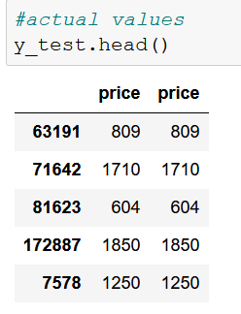
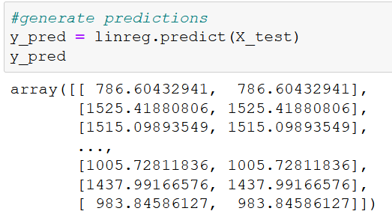
Machine Learning
Model Evaluation
Compare actual Data to predicted data

Slide 4
Machine Learning
Model Evaluation
Regression Evaluation Metrics
Mean Absolute Error (MAE) | R-square Score | Root Mean Square Error
188.0033932373231 | 0.7183884232251618 | 302.97929982393117

Slide 5
Q & A

